Slide 1
MEMORY INTERFACING

Slide 2
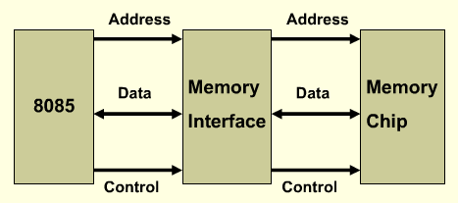
8085 interfacing with memory Chips
Microprocessor need to access memory quite frequently to read instructions and data stored in memory; the interface circuit enables that access.
The interface process involves designing a circuit that will match the memory requirements with the microprocessor signal.[Memory has certain signal requirements to read from and write into memory. Similarly Microprocessor initiates the set of signals when it wants to read from and write into memory].
*
Notes:
*

Slide 3
Memory interfacing to 8085 1.8085 has 16 bit address bus; hence it can access 2¹⁶ no. of memory locations, which is equal to 64KB memory. 2.Memory is required to store program as well as data. 3.Since microprocessor doesn’t have on-chip memory, we need to connect it externally.

Slide 4
Steps involved in interfacing memory with 8085 processor 1.Depending on the size of memory address lines are required. (EX. size is 4KB (2¹² ) i.e. 12 address lines are needed to identify locations and rest will be used for address decoding. 2.The address decoding circuit can be used using Gates/Decoder. 3.Connect data bus of memory to processor data bus 4. Generate control signals and then initiate memory select pulse

Slide 5
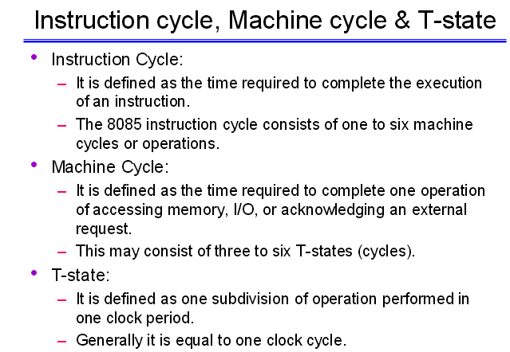

Slide 6
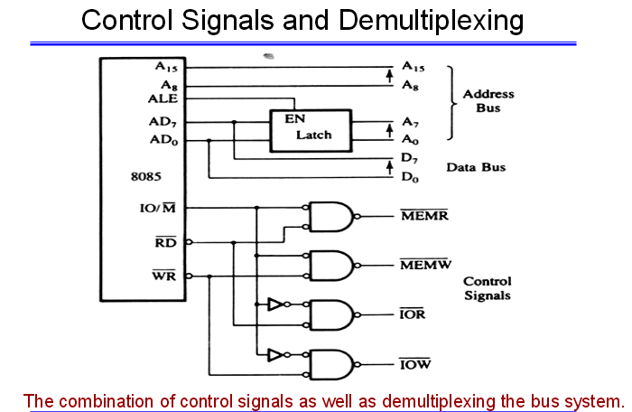

Slide 7
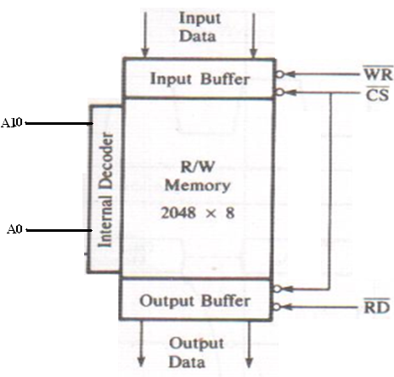
Memory Structure and its Requirements
R/W Memory: Group of Registers.
Figure Shows:
2048 registers
Register store 8-bits
8 input, 8-output lines
11 address lines(AD10-AD0), 1 chip select, 2 control lines to enable input and output buffer.
Internal decoder to decode address lines
Fig: R/W Static Memory
*
Notes:
*

Slide 8
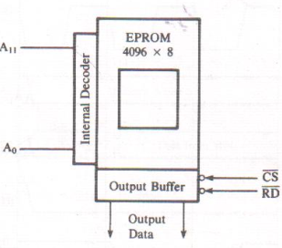
Memory Structure and its Requirements
EPROM : Chip must be programmed before it can be used as ROM.
4096 (4K) registers.
Register store 8-bits
8 input lines
Internal decoder to decode address lines.
12 address lines(A11-A0),
1 chip select
1 Read control Signal lines to
enable output buffer.
Fig: EPROM
*
Notes:
*

Slide 9
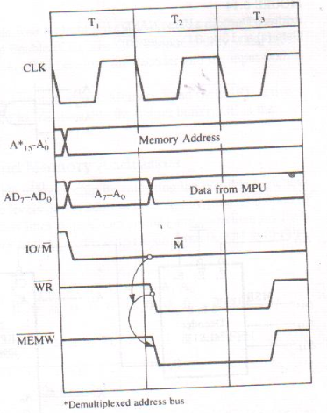
Basic concepts of Memory Interfacing
8085 places 16-bit address on address bus
11 low order address lines are required to select the register for EPROM.
Remaining 8085 address lines (A15-A11) should be decoded to generate chip select.
MEMR’. MEMW’ control signals that can be used to enable buffer for read and write operations.
Memory places data byte from address register during T2 and that is read by the microprocessor before the end of T3.
Fig: Timing Diagram of Memory Write Cycle
*
Notes:
*

Slide 10
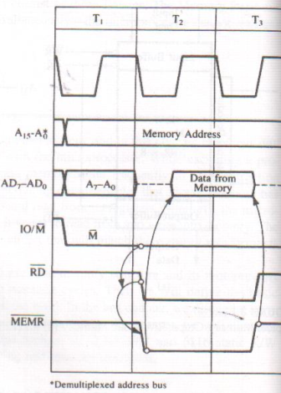

Basic concepts of Memory Interfacing
Primary Function of memory interfacing is that the microprocessor should be able to read from and write into a given register of a memory chip:
Select the Chip
Identify the register
Enable the appropriate buffer.
Timing Diagram of 8085 Memory Read/Write Machine Cycle allows to understand microprocessor interfacing concepts.
Fig: Timing Diagram of Memory Read Cycle
*
Notes:
*

Slide 11

Basic concepts of Memory Interfacing
*
Notes:
*

Slide 12

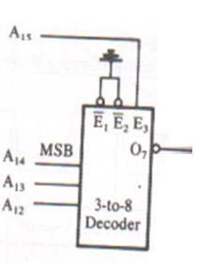
Address Decoding and Memory Addresses
EPROM Address Lines A11-A0 are connected to memory chip.
Remaining Address lines A15-A12 of 8085 microprocessor must be decoded.
Two methods to decoding these lines:
by NAND gate: Output of NAND gate is active and select the chip only when all address lines A15-A12 are at logic1
by using 3x8 Decoder: If enable line is active eight different logic combination can be identified by output line O7.E1 and E2 are enable by grounding and A15 must be at logic 1.
A15 A14 A13 A12 A11 A10 A9 A8 A7 A6 A5 A4 A3 A2 A1 A0
0 0 0 0 0 0 0 0 0 0 0 0 0 0 0 0 0000H
Chip Select 1 1 1 1 1 1 1 1 1 1 1 1 0FFFH
*
Notes:
*

Slide 13
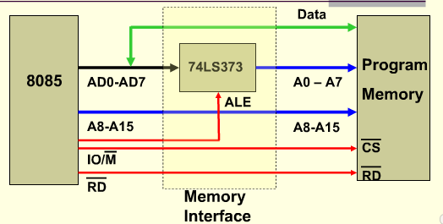
Interfacing Circuit
Fig :
*
Notes:
*

Slide 14
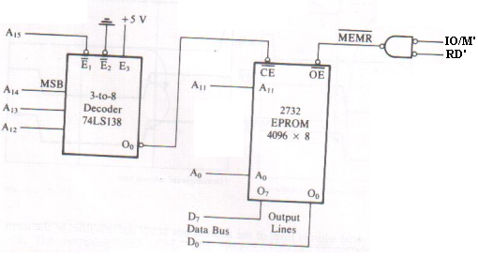
Interfacing Circuit
Fig: Interfacing Circuit using 3x8 Decoder to interface 2732 EPROM.
The 8085 address lines A11-A0 are connected to the pins A11-A0 of the memory chip.
Decoder decode A15-A12 and output O0 is connected to CE’ which is asserted only
when A15-A12 is 0000 (A15 low enables decoder and input 000 asserts the output O0).
One control signal MEMR’ is connected to OE’ to enable output buffer.
*
Notes:
*

Slide 15
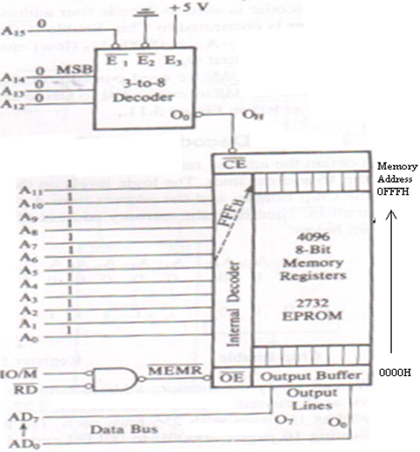
Interfacing Circuit
Fig: Address decoding and reading from memory.
Examine how 8085 places the address 0FFFH on address bus.
The address 0000H goes to decoder.
Output line O0 of the decoder selects the chip.
Remaining address lines FFFH goes on address lines of the chip and the internal decoder decodes the address and selects the register FFFH.
When RD’ is asserted the output buffer is enabled and the contents of register 0FFFH are places on the data bus for the processor to read.
*
Notes:
*

Slide 16
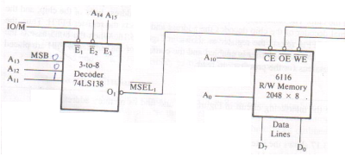
Interfacing 6116 Memory Chip with 2K Registers
11 Address lines A10-A0 to decode 2048K registers.
Address lines A15-A11 are connected to decoder(which is enabled by IO/M’ signal in addition to the address lines A15 and A14).
RD’ and WR’ signals are directly connected to memory chip.
MEMR’ and MEMW’ need not to be generated separately (this technique save two gates).
Memory Address Ranges from 8800H to 8FFFH.
A13-A11(001) activate output O1 of decoder which is connected to CE’ of memory chip
and it is asserted only when IO/M’ is low.
A15 A14 A13 A12 A11 A10 A9 A8 A7 A6 A5 A4 A3 A2 A1 A0
1 0 0 0 1 0 0 0 0 0 0 0 0 0 0 0 8800H
Chip Select 1 1 1 1 1 1 1 1 1 1 1 1 8FFFH
Fig: Interfacing R/W Memory
*
Notes:
*

Slide 17
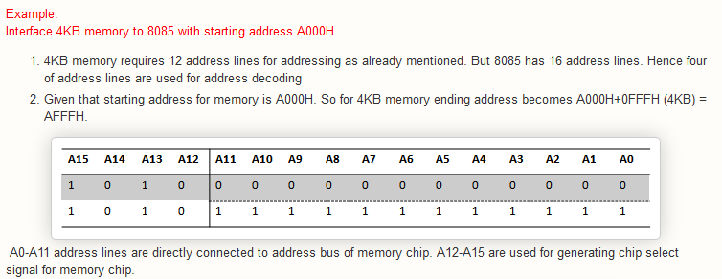

Slide 18
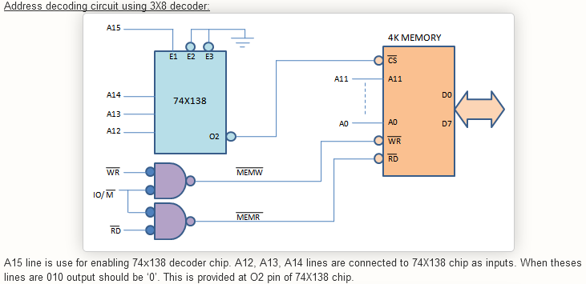

Slide 19
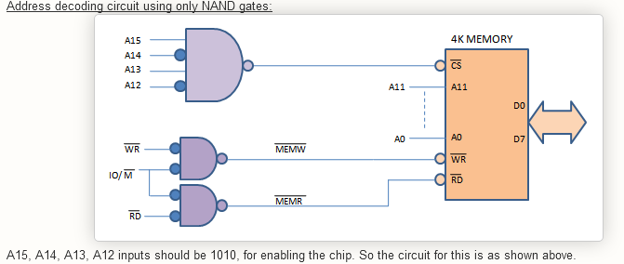

Slide 20
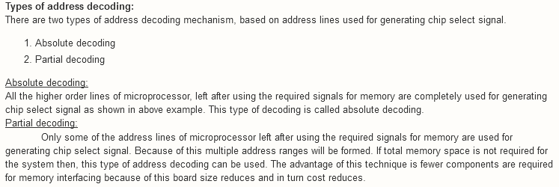

Slide 21
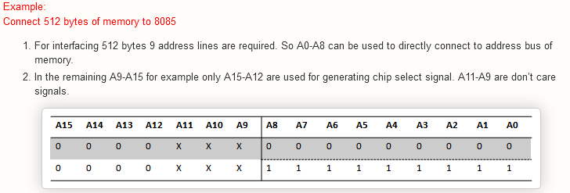

Slide 22
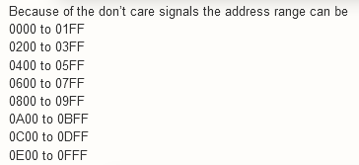

Slide 23
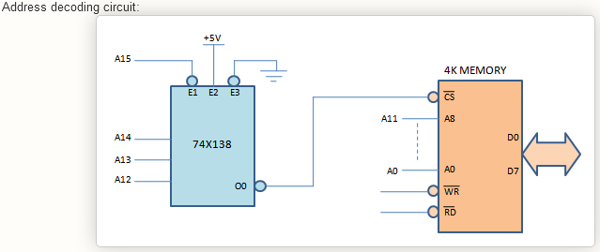

Slide 24
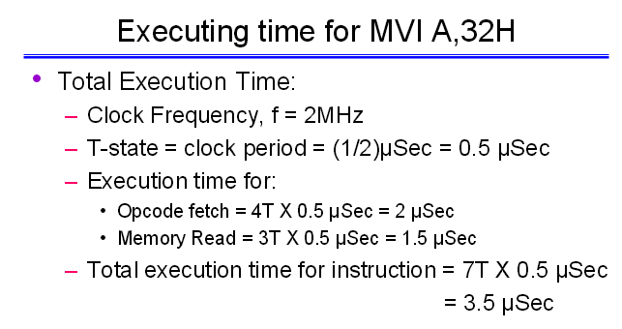

Slide 25
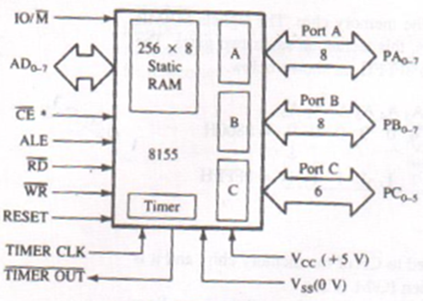
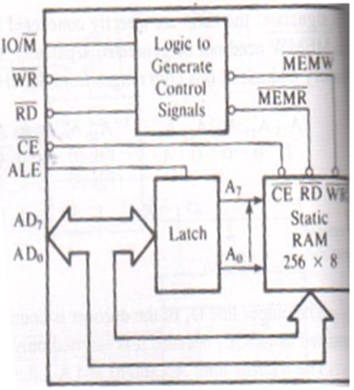
8155 Memory Segment
Fig: 8155 Memory Section Block Diagram
Fig: 8155 Memory Section Internal Structure
8 Address lines.
One CE’.
5 Control and status signals (IO/M’, ALE, RD’, WR’ and RESET).
Includes 256x8 memory locations
Internal latch for de-multiplexing
CE’, MEMR and MEMW’ control signals
*
Notes:
*

Slide 26
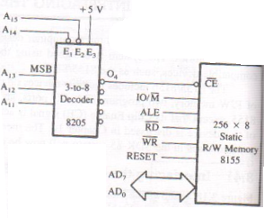
Interfacing the 8155 Memory Segment
8205, a 3x8 Decoder, decodes the address lines A15-A11, O4 enables the memory chip. Control and status signals from 8085 are connected to the respective signals of memory chip.
A7-A0 address any one of the 256 registers.
A14-A15 are active low and third line is permanently enable by tying it with +5V.
A10-A8 are not connected(don’t care lines).
O4 is low for following address.
A15 A14 A13 A12 A11 A10 A9 A8
0 0 1 0 0 0 0 0 20H
Memory Address range is from 2000H to 20FFH (When don’t care lines are at logic 0, by convention it is called primary address remaining are fold back memory or mirror memory).
Fig: Interfacing 8155 Memory schematic from SDK-85 System
*
Notes:
*

Slide 27
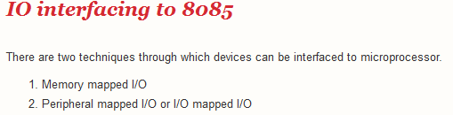

Slide 28
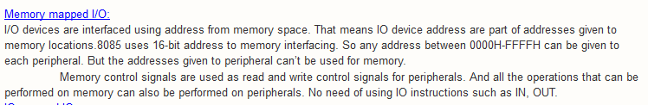

Slide 29
